Slide 1
IIR Filters Simple IIR Filter Design Example

Slide 2
Simple IIR Filter Design Example
Analogue prototype transfer function:
Impulse response:
h
(
t
)
t
Impulse response
Notes:
A simple first-order low pass filter illustrates several of the contrasting characteristics of the impulse invariance and bilinear transform design methods. The time domain impulse response of the filter with the transfer function H(s) is shown in this slide.

Slide 3
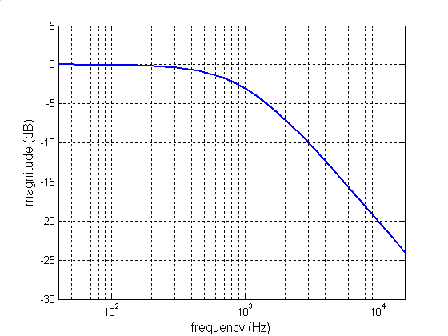
Simple IIR Filter Design Example
Analogue prototype transfer function:
Impulse response:
Magnitude frequency response
Notes:
This slide shows the corresponding magnitude frequency response.
The pass band gain is unity, or 0 dB, and beyond the cut-off frequency, the gain rolls off at approaching 20dB per decade.

Slide 4
Simple IIR Filter Design Example
Use the following transform pairs taken from tables
The impulse response of the prototype filter is found by taking the inverse Laplace transform of the
filter transfer function.
The z-transfer function of the IIR filter is found by taking the z-transform of the continuous-time
impulse response.
This procedure is equivalent to the impulse invariant design method.
Notes:
In this slide, the impulse invariant design method is implemented using the Laplace and z-transform pairs.

Slide 5
Simple IIR Filter Design Example
The discrete-time filter described by the z-transfer function
is an IIR filter with the following coefficient values
It differs from the analogue prototype filter in that its dc gain (found by setting z = 1 in H(z)) is
DC gains may be matched by setting
Notes:
The initial value theorem for z-transfer functions follows from the definition of the complex variable z.

Slide 6
Simple IIR Filter Design Example
The difference equation representing the impulse invariant IIR filter is
Notes:
The difference equation representation of an IIR filter follows from the time delay property of the z-transform.

Slide 7
Simple IIR Filter Design Example
In block diagram form, our impulse invariant filter design is
Notes:
The block diagram shown here is laid out deliberately as a subset of the block diagram of an IIR filter shown at the start of the previous module. All coefficients except b0, a0, and a1 are equal to zero. Recall that by convention, a0 = 1.
The difference equation representation of the IIR filter is a good starting point if you want to implement it on a processor, or in hardware.

Slide 8
Simple IIR Filter Design Example
Alternatively, an IIR filter may be derived from the analogue prototype using the bilinear transform
yielding the filter coefficients
The DC gain of this filter is unity – matching that of the analogue prototype.
Notes:
The bilinear transform method, applied the same analogue prototype filter, yields an extra non-zero IIR filter coefficient, b1. As far as we’re concerned at the moment, that’s just the way it turns out.

Slide 9
Simple IIR Filter Design Example
The difference equation representing the bilinear transform IIR filter is

Slide 10
Simple IIR Filter Design Example
In block diagram form, our bilinear transform filter design is

Slide 11
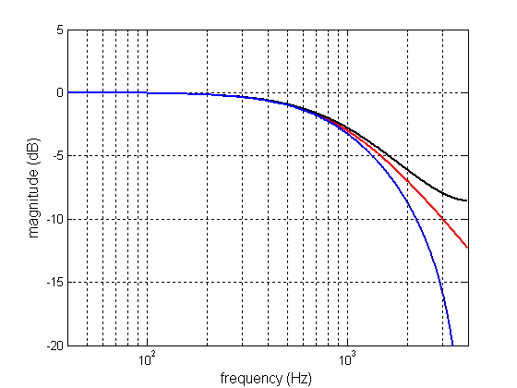
Simple IIR Filter Design Example
a)
b)
c)
b)
a)
c)
Notes:
The (continuous) frequency responses of the analogue prototype and two IIR filters are different. The IIR filter designed using impulse invariance shows the effects of aliasing – the gain of the low pass filter does not roll off as steeply as that of the analogue prototype. The gain of the IIR filter designed using the bilinear transform rolls off more steeply than that of the analogue prototype. While the BLT filter might be regarded as a more effective low pass filter than either of the others, recall that the initial aim was to reproduce the characteristics of the analogue prototype. The gain of the BLT filter does not accurately reproduce that of the analogue prototype at higher frequencies.

Slide 12
Alternative IIR Structures
Direct form I representation of a second-order IIR filter
Notes:
The block diagram and difference equation representations of IIR filters presented earlier conform to what is called direct form I filter structure.

Slide 13
Alternative IIR Structures
Direct form II representation of a second-order IIR filter
Notes:
Direct form II structure uses fewer delay blocks and stored previous values (it stores previous values of intermediate results w(n-1) and w(n-2)) and corresponds to a two-step difference equation implementation.

Slide 14
Alternative IIR Structures
Cascaded second-order stage (SOS) implementation of fourth-order IIR filter
Notes:
Cascaded second-order stage (SOS) implementation of higher order IIR filter reduces potential for instability due to rounding errors. MATLAB’s fdatool generates SOS coefficients.

Slide 15
IIR filters vs. FIR filters
Steep (selective) filters achievable using fewer coefficients (and less computation)
Leverage of established analogue filter design knowledge
Potential instability

